Slide 1


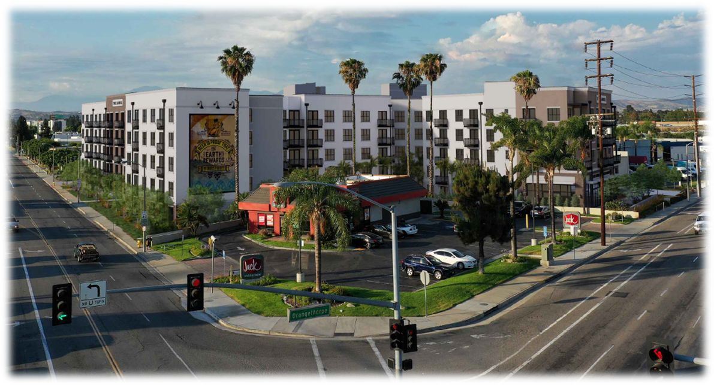
City of Placentia
ORANGETHORPE AVENUE MIXED USE DEVELOPMENT
COMMUNITY MEETING
JANUARY 25, 2024

Slide 2
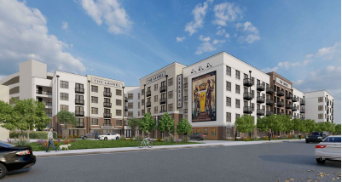
PRESENTATION OVERVIEW
AGENDA
Welcome and Introduction
Project Overview
Design & Architecture
Environmental Review
Community Benefits
Timeline and Milestones
Q & A Session
Closing Remarks

Slide 3
Community Meeting Decorum
These rules aim to create a positive and inclusive atmosphere, ensuring that the community meeting remains a space for constructive dialogue and collaboration.
Respectful Communication: Participants should communicate respectfully with each other, avoiding offensive language or personal attacks.
Listening: Attendees should actively listen to others, allowing everyone the opportunity to express their opinions without interruption.
Agenda Adherence: Participants should stick to the agenda and avoid going off-topic. This helps the meeting stay focused and productive.
Time Management: Respect the allocated time for the community meeting to ensure that all topics can be covered within the scheduled meeting duration.
Raise Hand: To speak, participants may be required to raise their hand or wait for the designated time for public comments. This helps maintain order and prevents disruptions.
Limit Speaking Time: To give everyone an opportunity to speak, there may be limits on the amount of time each participant is allowed to speak.
Cell Phone Etiquette: Participants should silence their cell phones or other electronic devices to minimize disruptions.

Slide 4
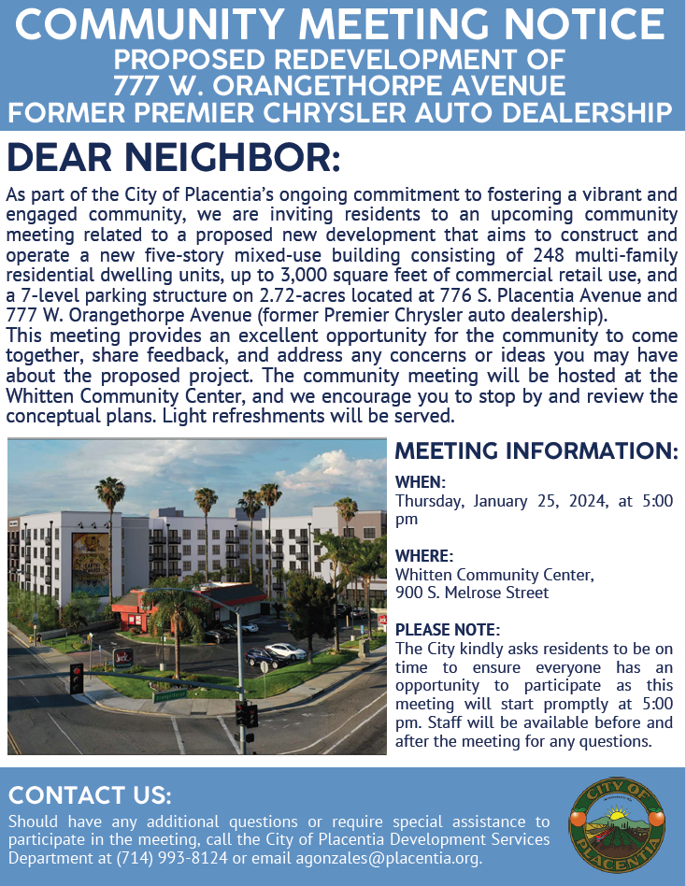
WELCOME & INTRODUCTION
Meeting Purpose & Objective
Review the project proposal
Discuss and compile feedback and/or concerns about the proposed development project
Answer any project related questions
Goal
Utilize all feedback received from community members and stakeholders to assist both the City of Placentia Planning Commission and City Council in the decision-making process.

Slide 5
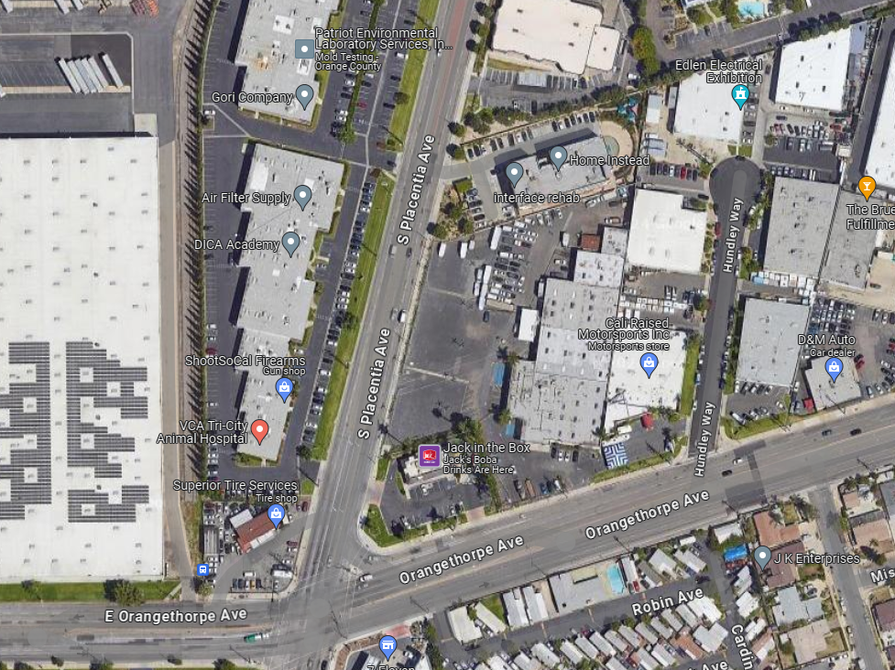
PROJECT OVERVIEW
Location
776 S. Placentia Avenue & 777 W. Orangethorpe Avenue, NEC of Placentia Avenue and Orangethorpe Avenue
2.72-acre site of the former Premier Chrysler Jeep of Placentia auto dealership
Southwest border of the City of Placentia, abutting the cities of Anaheim and Fullerton
City of Fullerton
City of Placentia
City of Anaheim

Slide 6
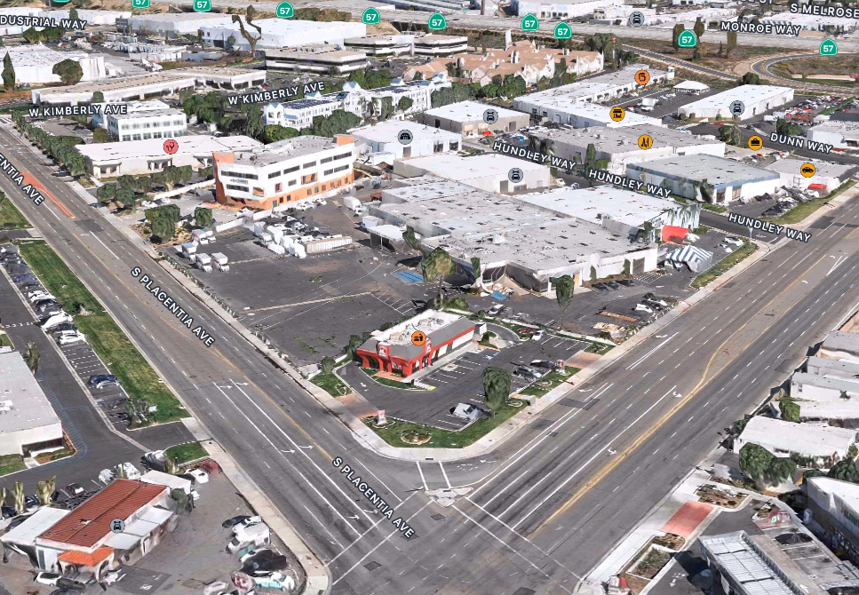
Project Overview

Slide 7
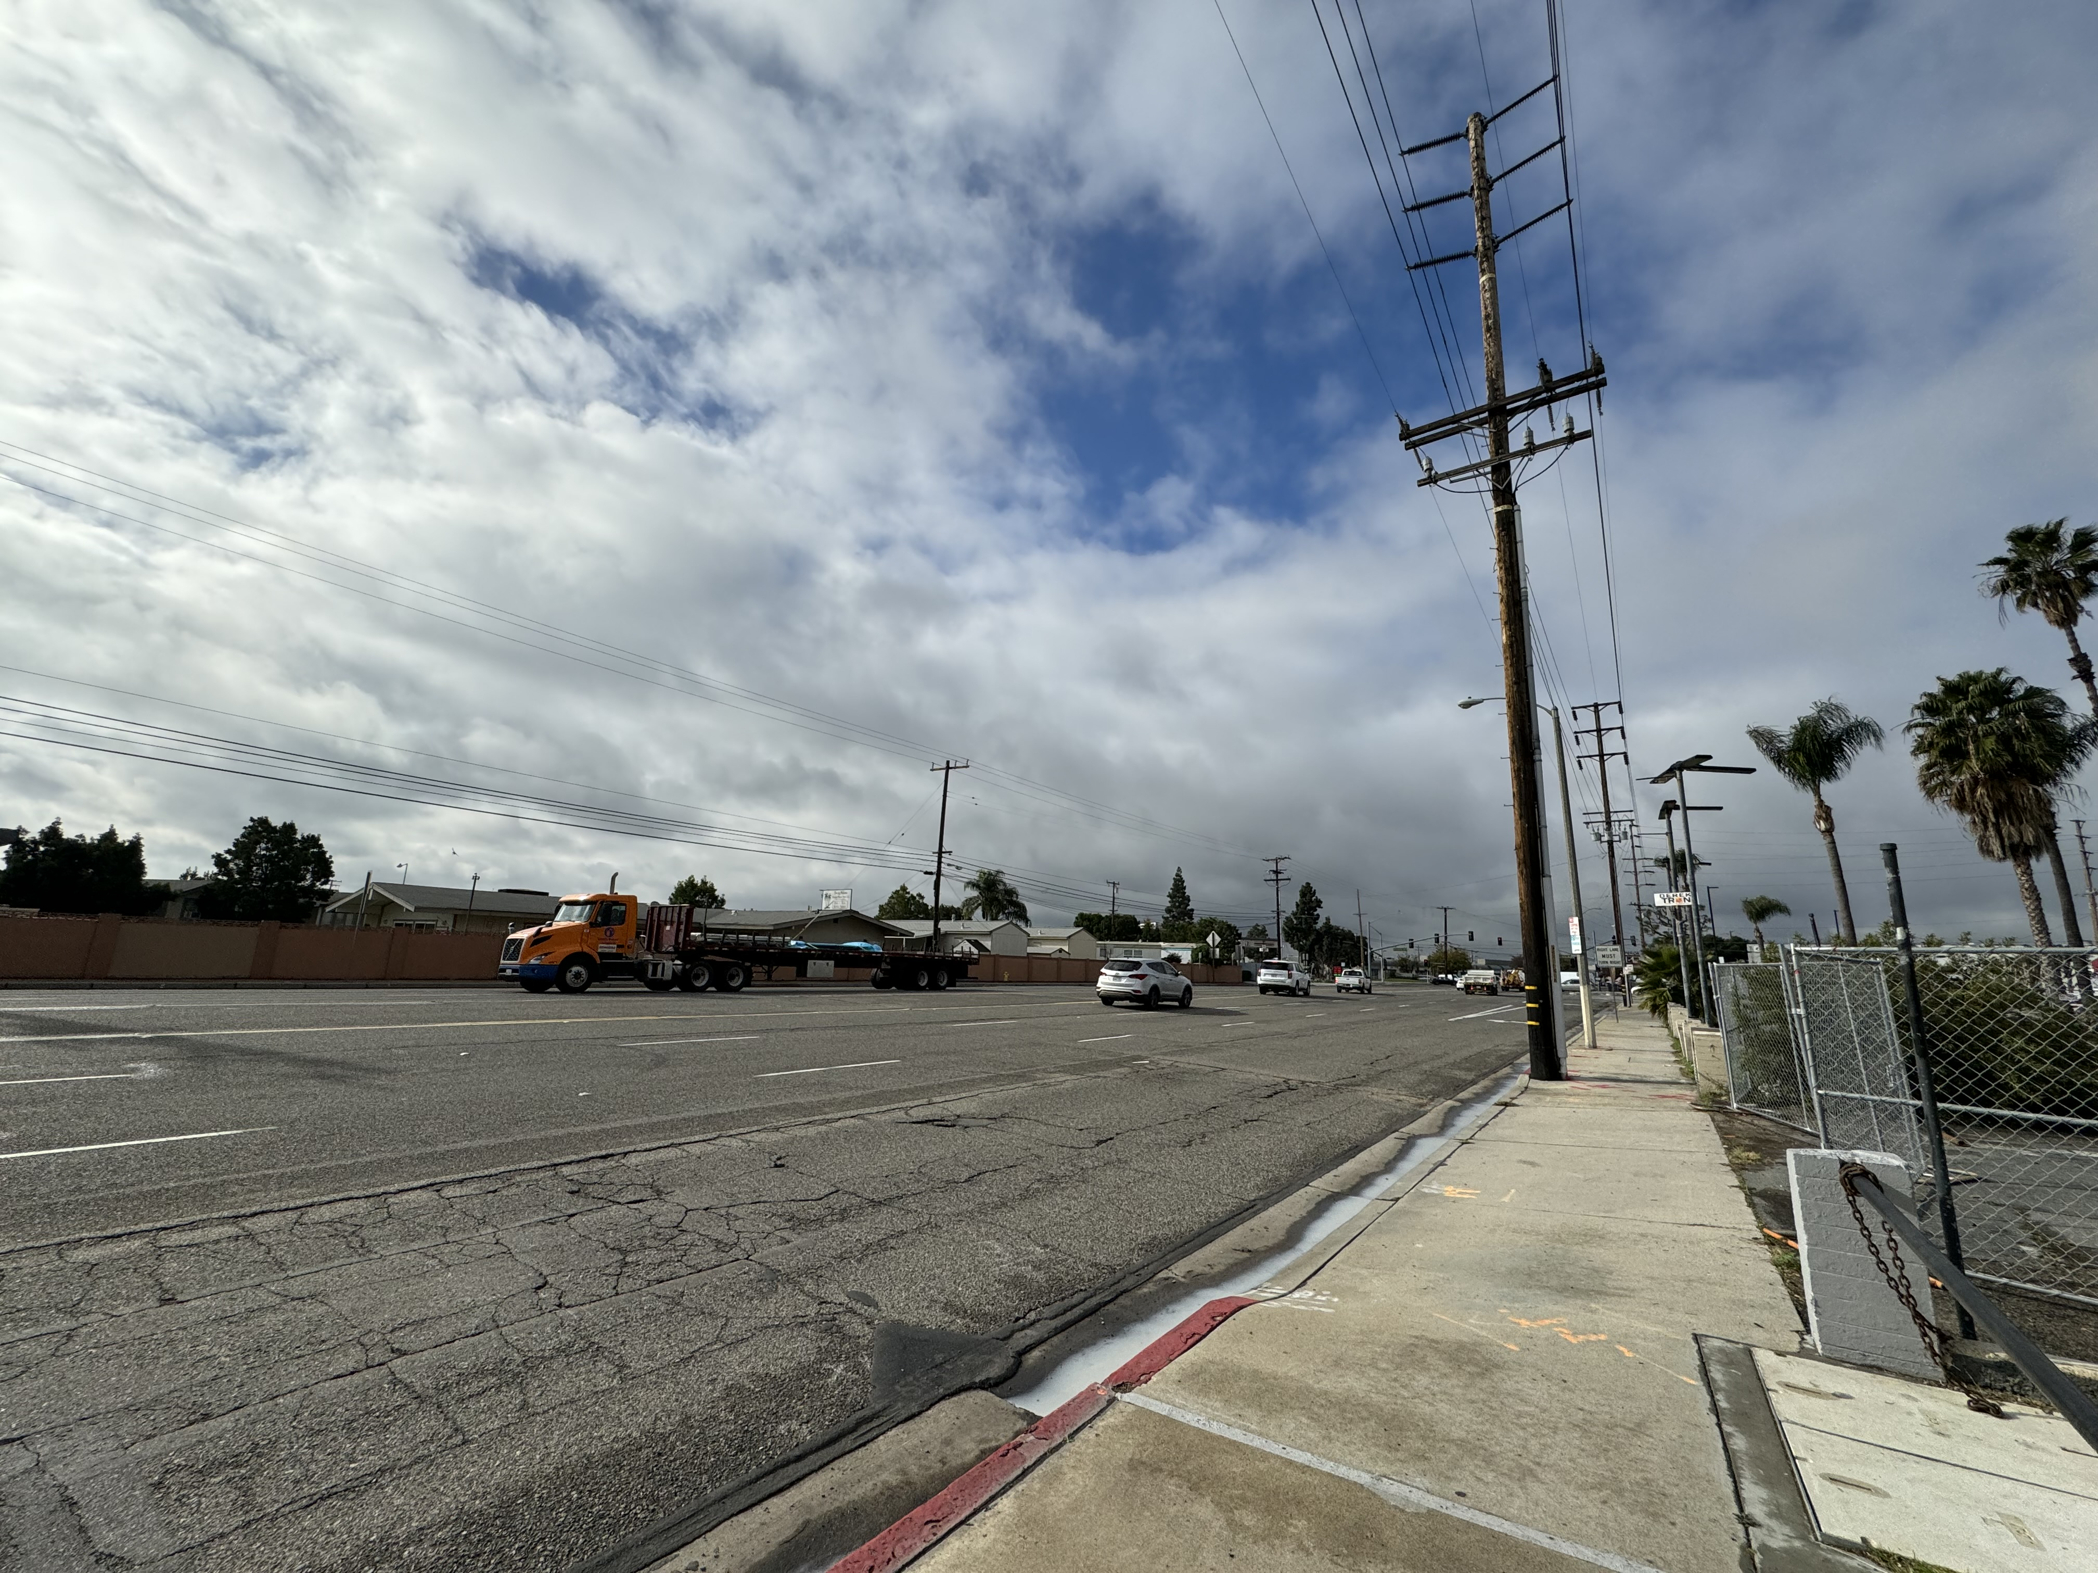

Slide 8
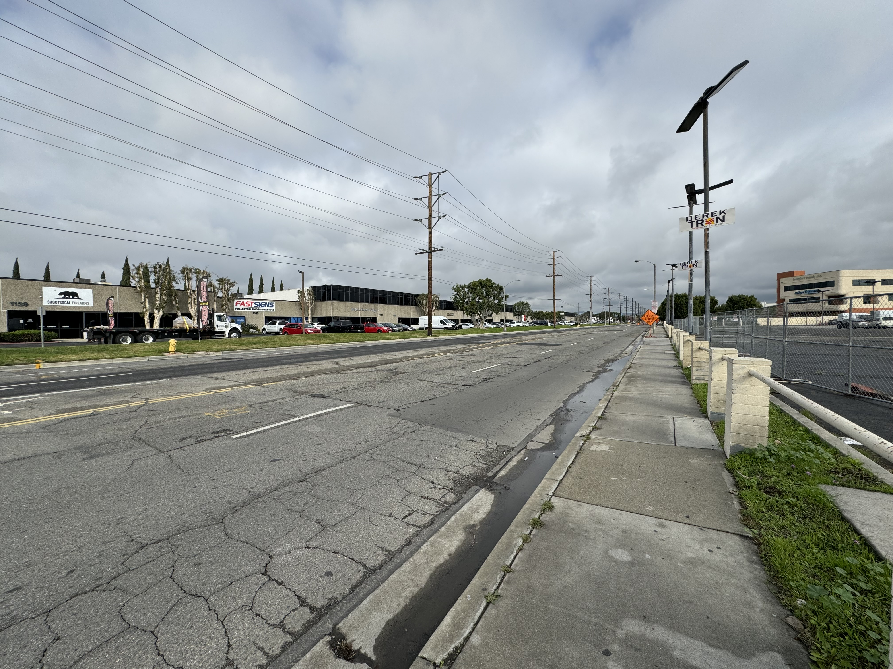

Slide 9
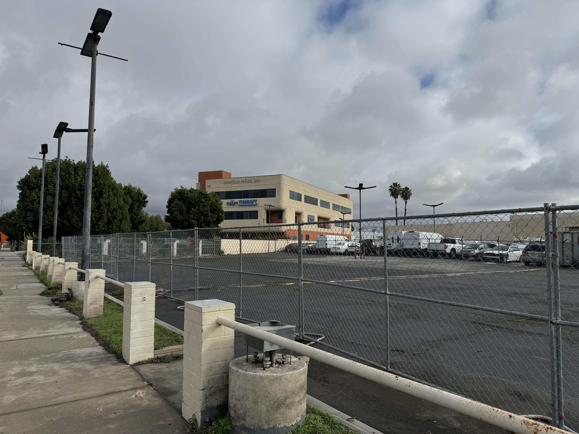
agonzales@placentia.org

Slide 10
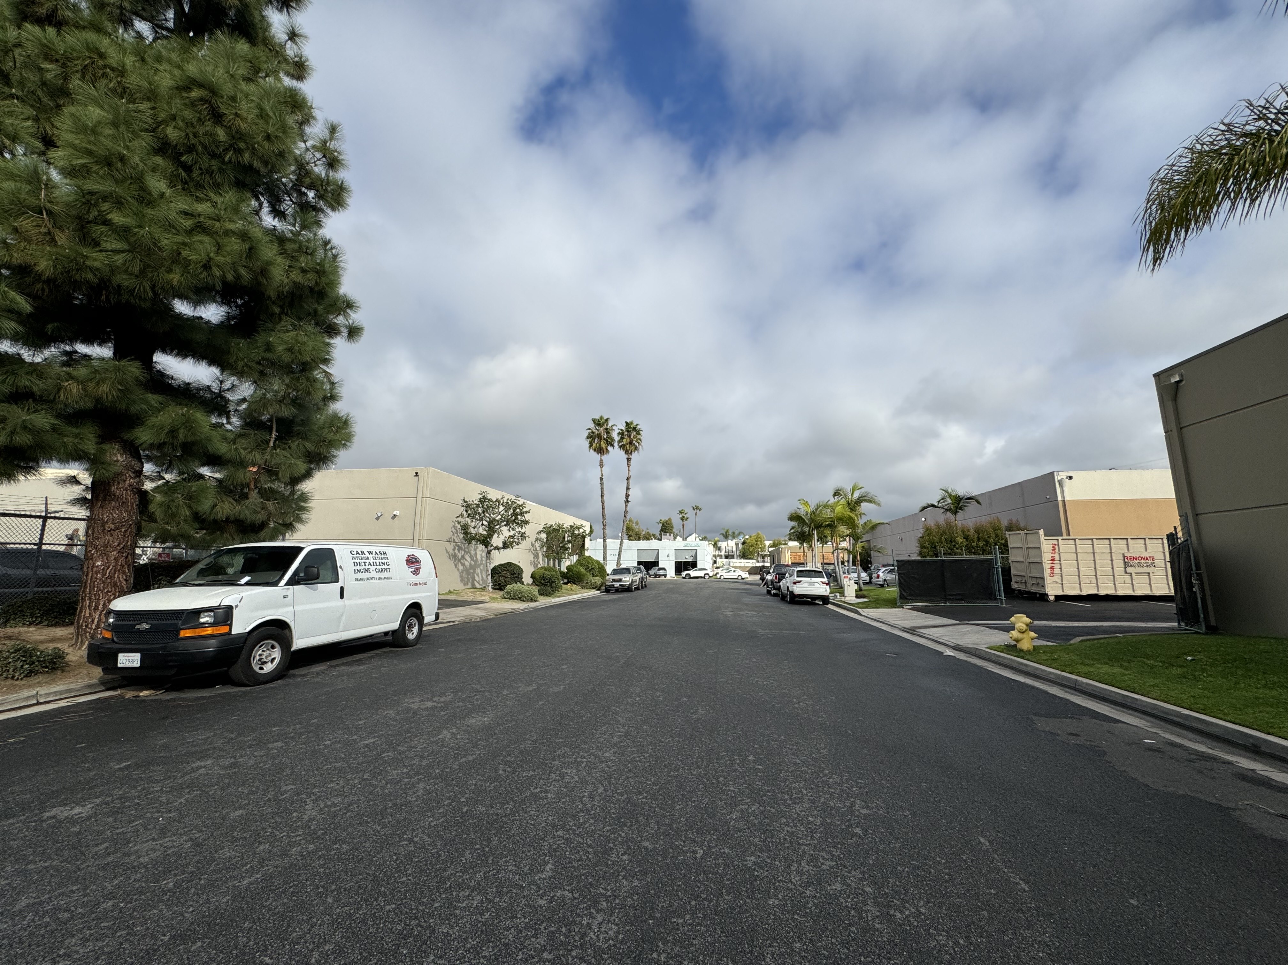
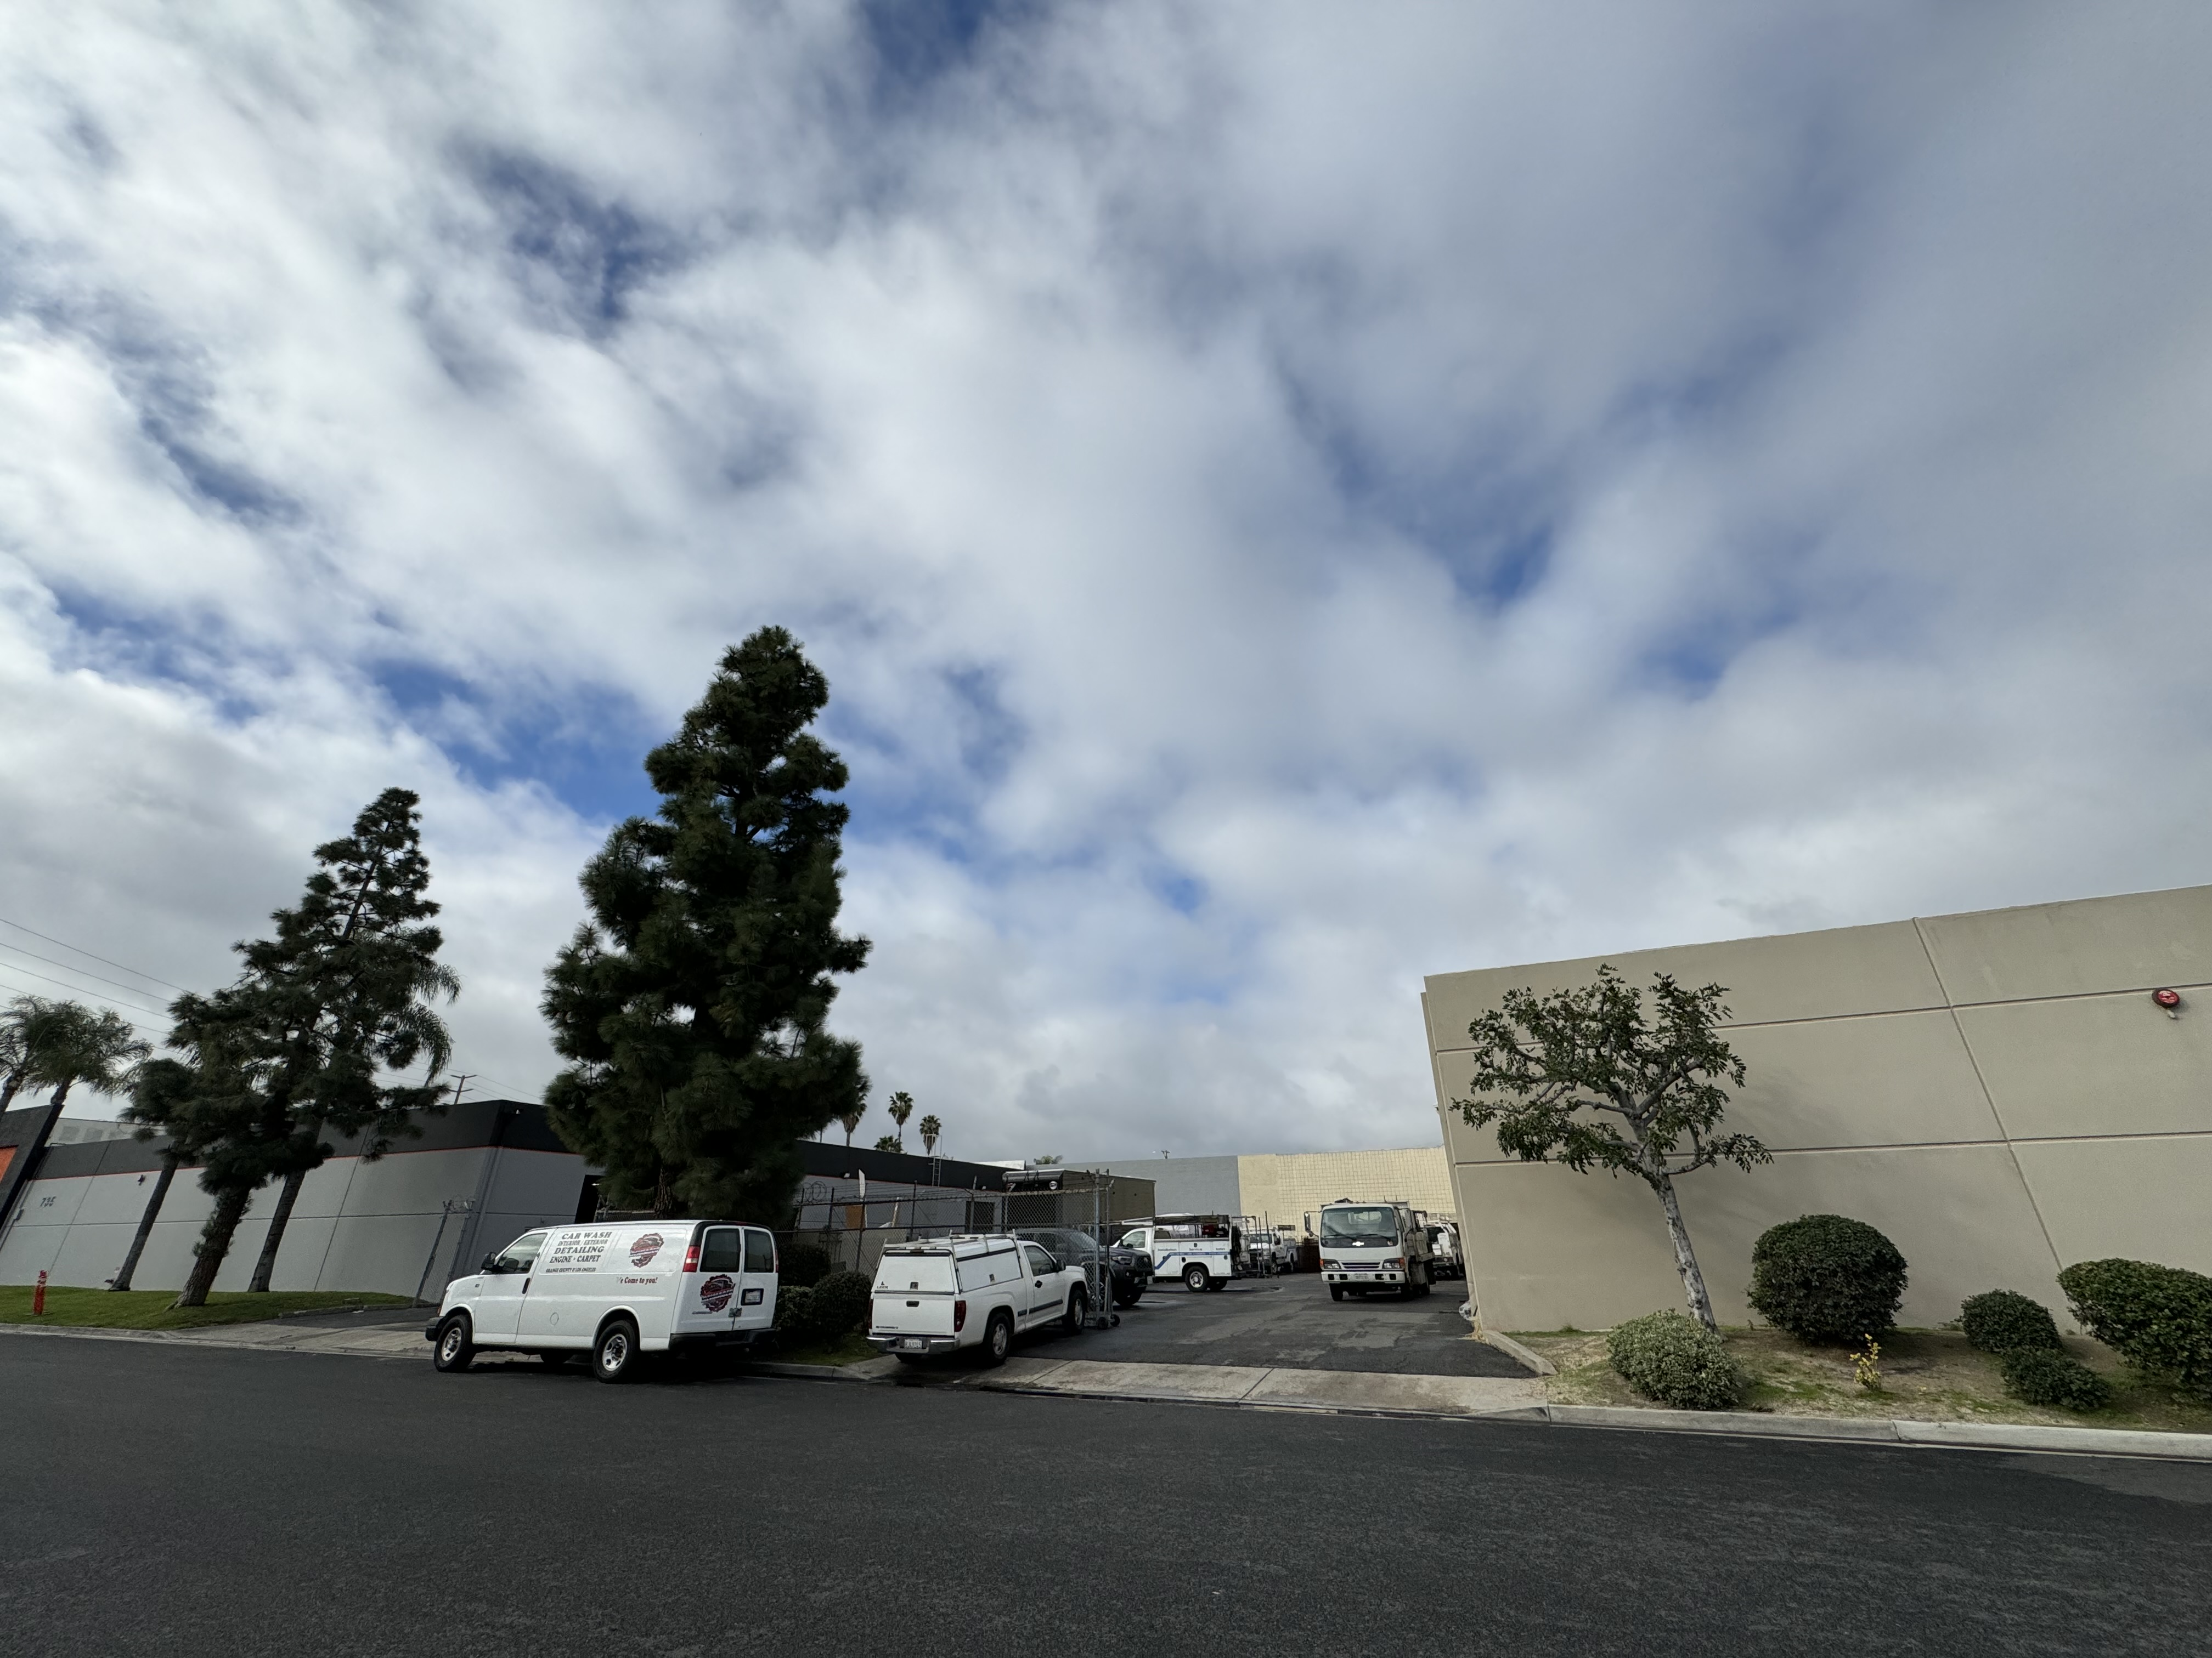

Slide 11
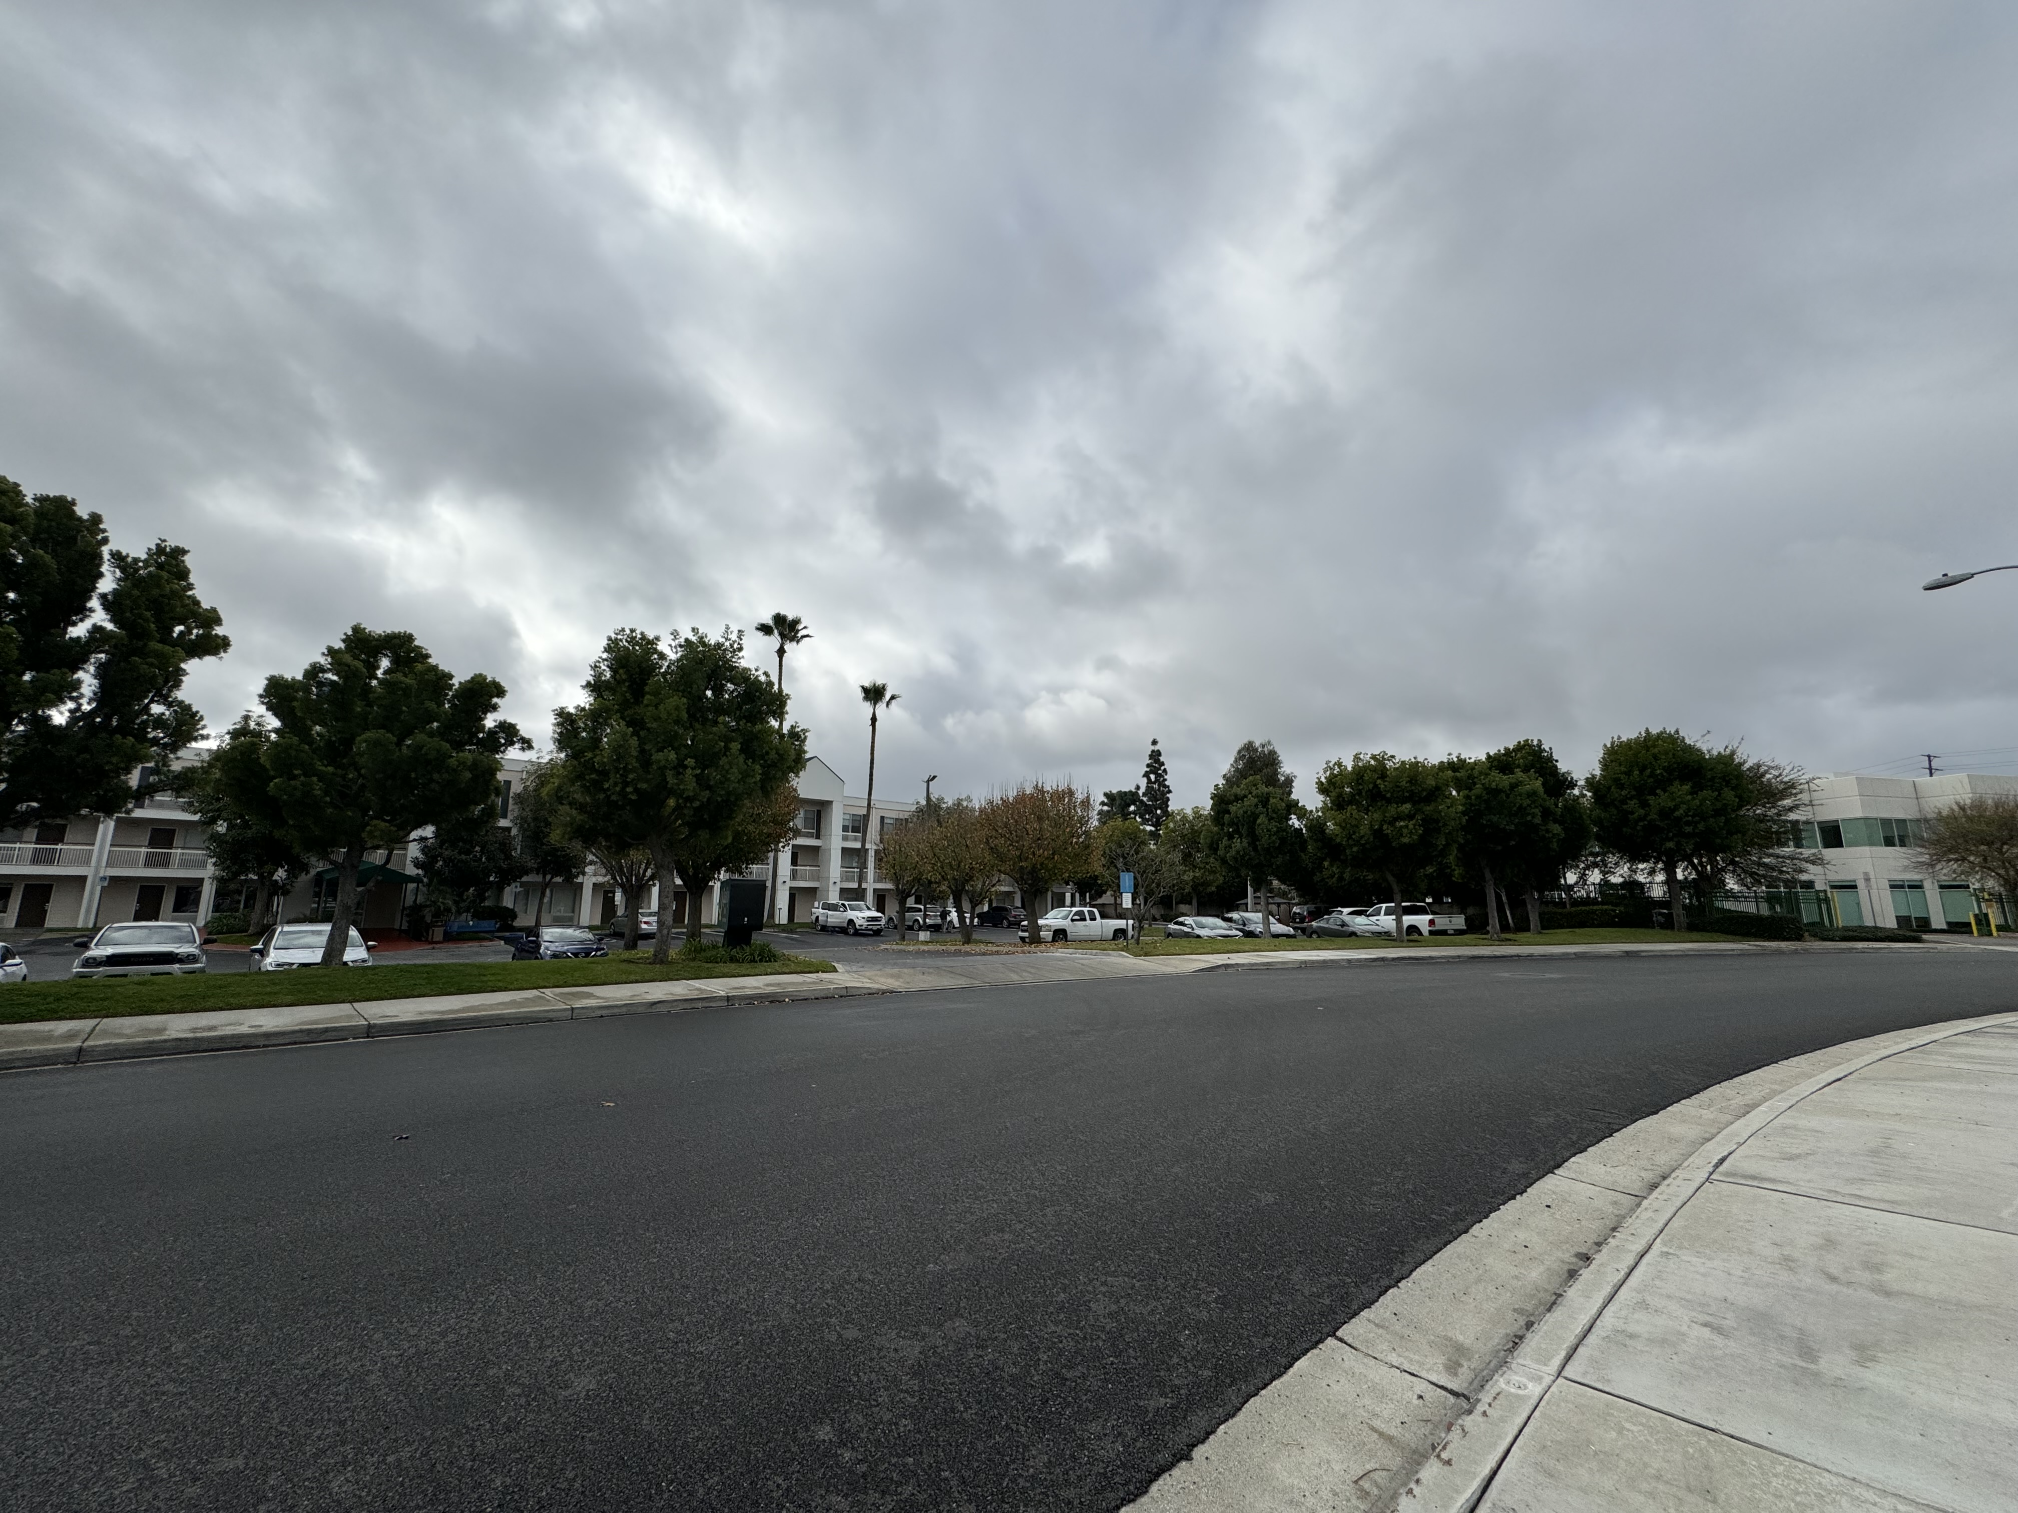

Slide 12
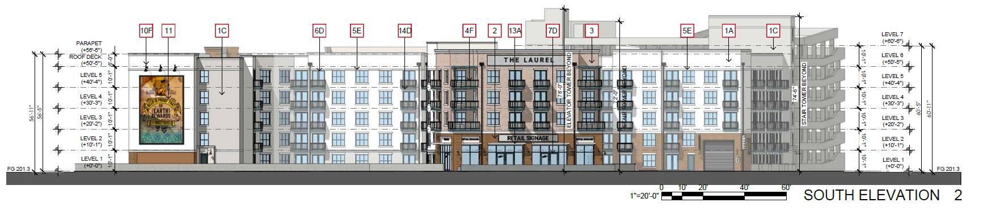
PROJECT OVERVIEW
Proposed development of a five-story mixed use building consisting of:
248 residential apartment units
Studio, 1 bedroom, and 2-bedroom plans (571 sf – 1,087 sf)
± 2,703 square feet ground floor retail
7-level parking structure (151,900 GSF) with 342 parking spaces provided
Overall height at 56’-11” for residential building and 78’-0” for the highest point of the parking structure
Vehicular ingress/egress access from both Orangethorpe and Placentia Avenues

Slide 13
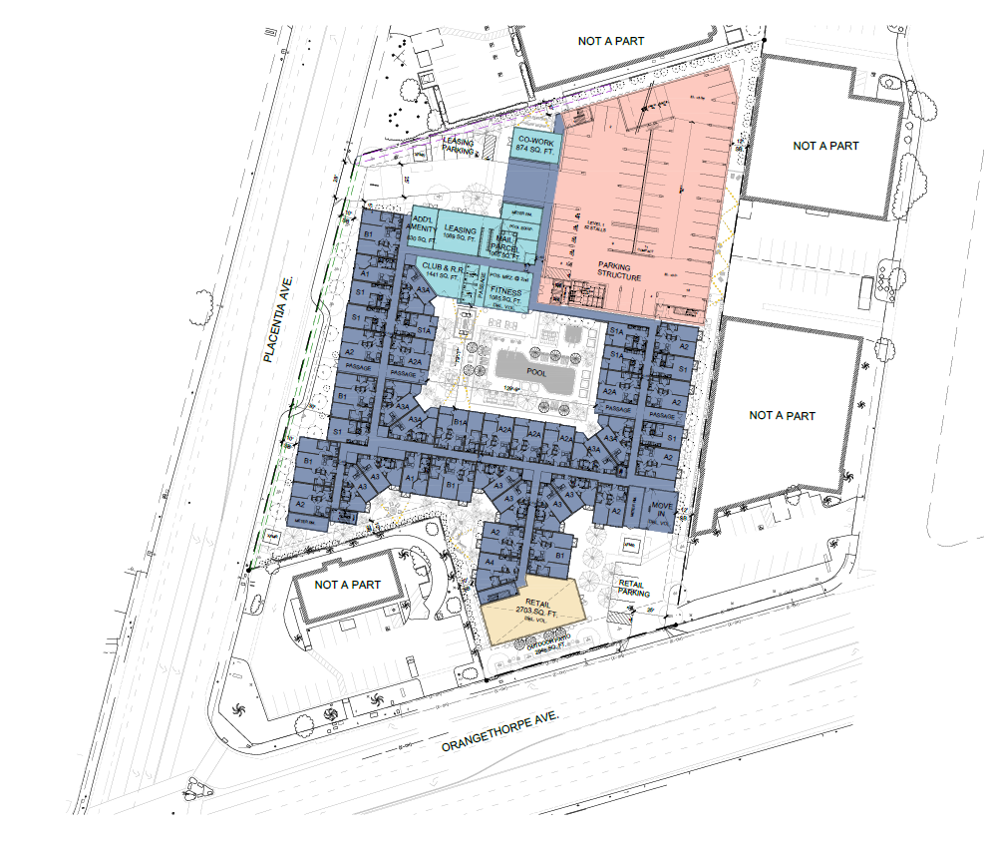
Location & Site Plan

Slide 14
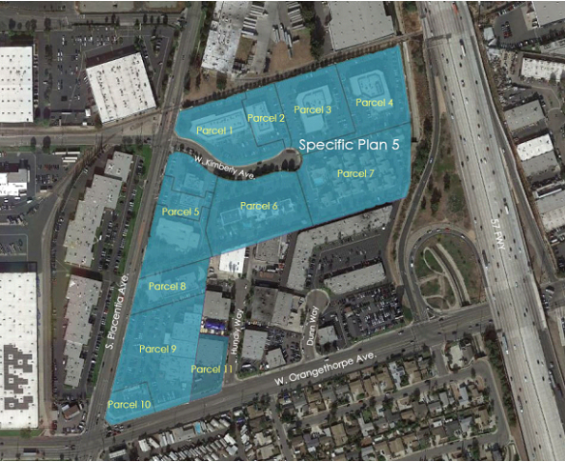
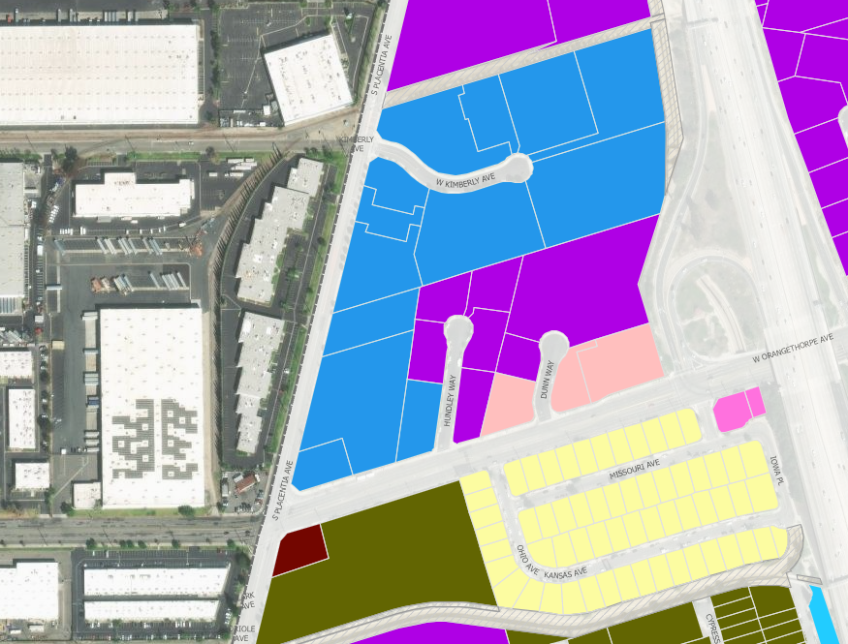
Location & Site Plan
Zoning
Specific Plan 5 (SP5) – Parcel 9
Vehicle dealerships, hospitality uses, general retail, financial, office, medical, and restaurant uses are permitted
Residential uses are not permitted in SP5
General Plan
Land Use Designation of “Specific Plan”
Residential is not identified as an allowed land use
Because of the nonconforming nature of the project, a General Plan Amendment (GPA) and Specific Plan Amendment (SPA) is required
M
M
SP5
M
C-2
R-1
C-1
R-1(MHP)

Slide 15
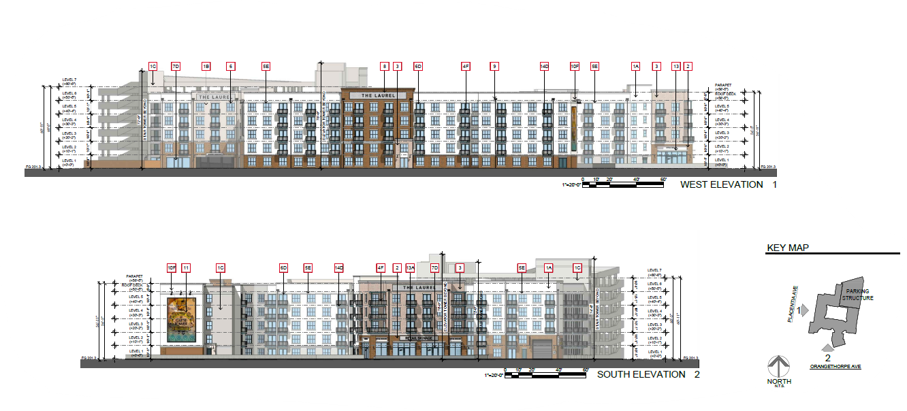
Design & Architecture
RETAIL

Slide 16
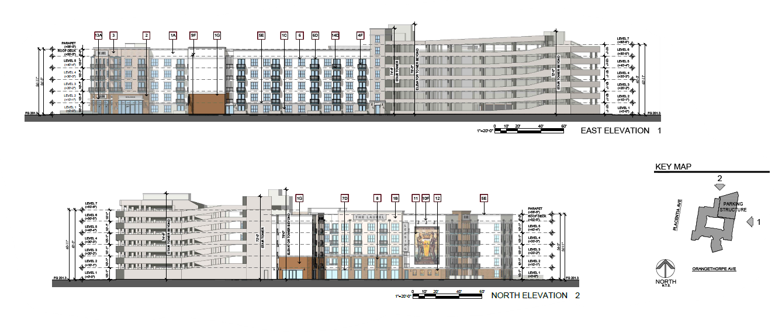
Design & Architecture

Slide 17
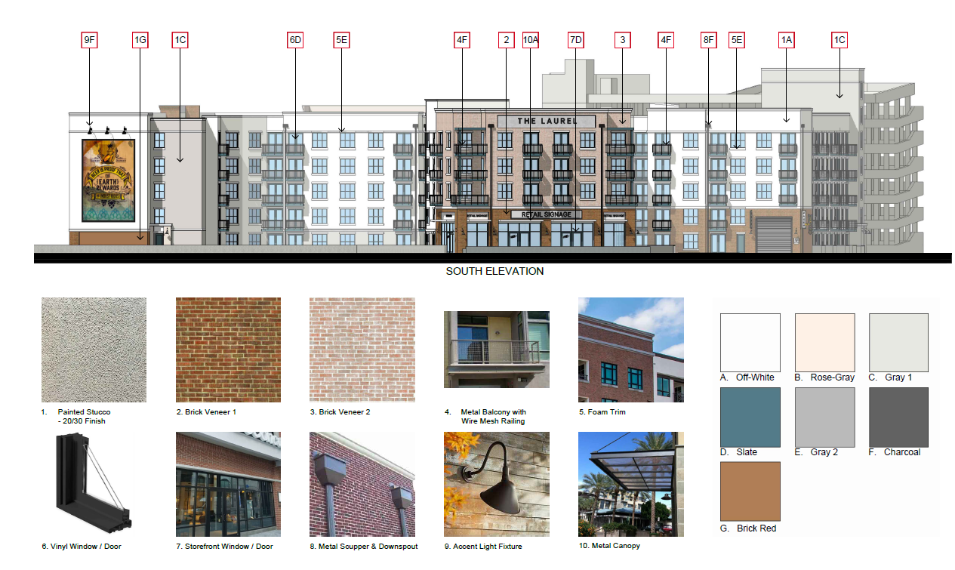

Slide 18
Environmental Review
Environmental checklist prepared by Harris and Associates and peer reviewed by the City’s CEQA consultant PGN which resulted in the preparation of a Mitigated Negative Declaration document
Studies prepared for the document included air quality, asbestos & lead, dry utility report, geotechnical investigation , water quality, sewer analysis, traffic study, water study, soil & soil vapor investigation, Phase 1 environmental analysis, and fire development plan review.
Nine mitigation measures in the areas of Cultural Resources, Geology & Soils, Hazards & Hazardous Materials, Tribal Cultural Resources
Notice of Intent mailed to property owners within 300 ft. of property, published in the local paper, and distributed to the Governor's Office of Planning Research (OPR)/State Clearing House for 30-day public review period.

Slide 19
Timeline and Milestones
DATE | ACTIVITY/TASK
June 24, 2021 | Application/Project Submitted
September 1, 2022 | Application Deemed Complete
November 29, 2023 | IS/MND Circulated for 30-day Public Review Period with a January 2, 2024 deadline for comments
January 25, 2024 | Community Meeting at Whitten Community Center
TBD | Planning Commission Meeting
TBD | City Council Meeting

Slide 20

Public Input & Feedback
Public engagement is of paramount importance across various sectors and initiatives, contributing to the democratic process, decision-making, and the overall well-being of communities. Here is a summary of the key aspects highlighting the importance of public engagement:
Democracy and Civic Participation
Transparency and Accountability
Informed Decision Making
Building Trust and Social Cohesion
Community Empowerment
Education and Awareness

Slide 21
Questions & Comments If you have further questions, you can contact Planning Manager, Andrew Gonzales, at (714) 993-8218 or via email at agonzales@placentia.org or visit www.placentia.org/776 for additional information on the project

Slide 22
Thank you for your participation!

